Slide 1
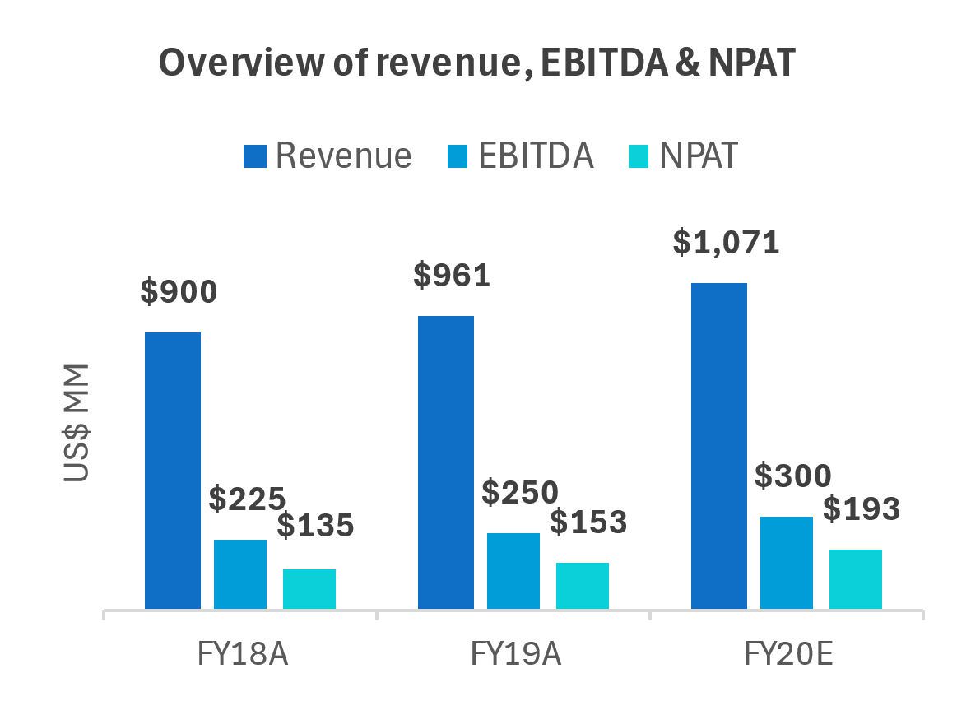
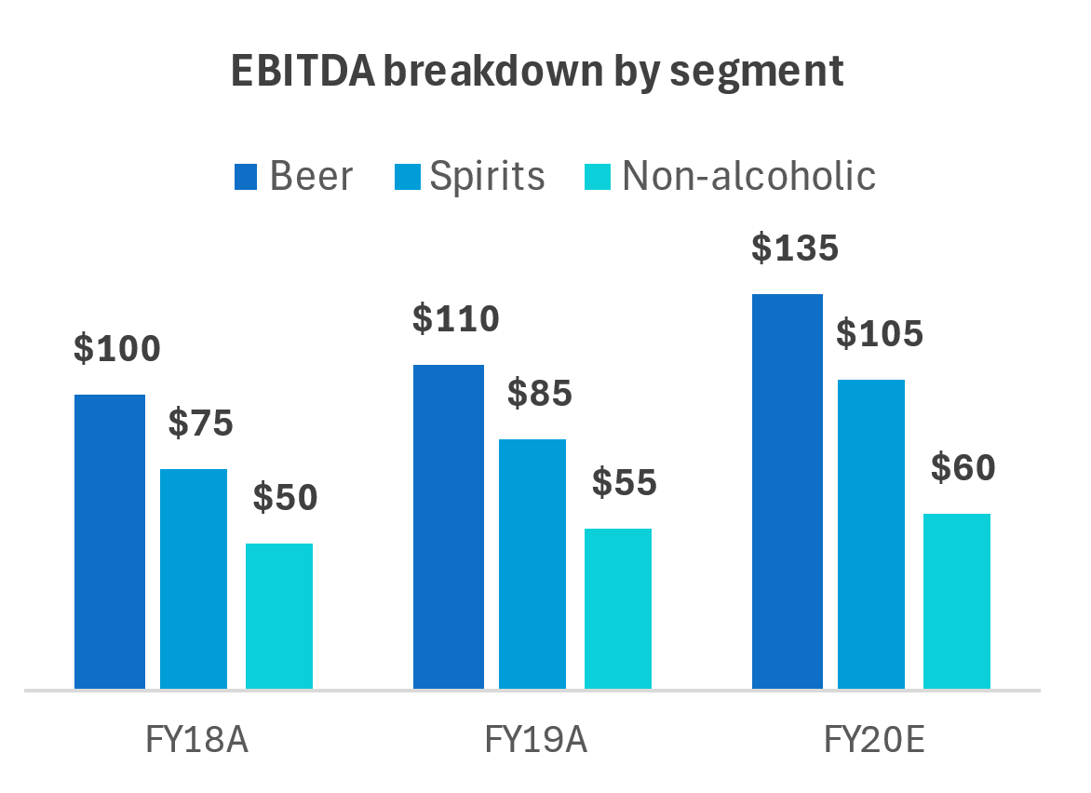
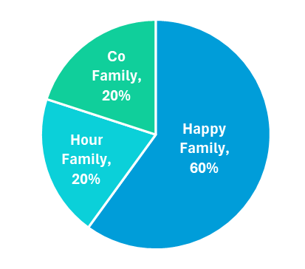
HappyHour Co. Company Profile
Overview
Key financials
Founded in 1975 by Ms. Happy (majority owner & co-founder)
HappyHour Co. operates in beer, spirit & non-alcoholic beverages segment which channels including both distribution and direct sales.
Headquartered in Singapore along with operations in Malaysia & China.
Recently expanded in China & new facilities planned for Cambodia. Upcoming bottling facilities in Cambodia.
Offers high quality product in spirit segment with premium valuation.
Market leader in beer, spirit (Singapore & Malaysia) and non-alcoholic (Malaysia).
Strong supply chain and distributor ties
Press articles quoting primary valuation of UD$ 3,500 mm.
Shareholders
Indicative valuation
Broker industry report indicates an EV/EBITDA multiple between 10x – 11.5x suggesting a positive future growth.
Company’s EBITDA margin was 25% & 26% in FY 2018 & 2019 respectively and expected to grow up to 28% in FY 2020
Historical net profit margin of HappyHour Co. in FY 2018 & 2019 was 15% & 15.9% respectively and is expected to grow up to 18% in FY 2020.
Favourable global M&A trend with conglomerates acquiring regional food & drink companies including beer & spirit companies.
Beer market in Asia expected to expand & growth at 10% CAGR. Expected rise in demand for tea over coffee as well as premium beers.
Key competitors include Spirit Bay, Hipsters’ Ale & Brew Co.
Source:
1

Slide 2
Overview of auction process and key workstreams
 | Date | Event | Key workstreams
Round 1: Indicative Bid Phase | Mar 19, 2020 | Access to Indicative Bid Documents | Access to transaction information memorandum, vendor due diligence and financial forecasts will be granted. Indicative Bid Documents allow bidders to submit an indicative bid in respect to this transaction and will be available via online data room. Bidders may submit up to 20 questions to financial advisor. Response to these questions will be provided by online data room. Source of questions will remain confidential. Bidder must submit the final Indicative Bid before mentioned date & time.
 | Apr 9, 2020, 9 AM – Apr 13, 2020, 5 PM (Hong Kong Time) | Indicative Bid Q&A Process
 | May 13, 2020, 5 PM (Hong Kong Time) | Final Indicative Bid Submission
Round 2: Final Bid Phase | Late May 2020 | Beginning of Final Bid Phase | The Final Bid Phase will begin will the release of Process Letter Two. Bidders will be shortlisted based on Indicative Bid. Final Bid will progress with Shortlisted Bidders. Shortlisted Bidders will need to submit full & legally binding bids (Final Bids). More electronic data in data room with due diligence materials for shortlisted bidders along with following material; Guided site visits Presentation from HappyHour’s management team Additional Q&A process Transaction implementation documentation
 | Late July 2020 | Submission of Final Bid
2

